Slide 1
Operating Systems
SENS-3513
Week: 5
Process Management - 3
Operating System Concepts
9th edition
Silberschatz, Galvin & Gagne
John Wiley & Sons
2013
Dr Nauman Mazhar
Faculty of Information Technology (FIT)
University of Central Punjab (UCP)

Slide 2
Objectives
Inter Process Communication
File Management in Linux
  open(), read(), write(), close() system calls
  PPFDT, SWFT & Inode Table
I/O redirection
  redirecting standard input, output & error
  I/O redirection in shell & C programs
  dup(), dup2() system calls
Standard IPC Methods
  Message passing, Shared memory
  Pipes, FIFOs, Sockets
  Programming Pipes / FIFOs in shell & C
2

Slide 3
  File Management
3

Slide 4
File Management in Unix/Linux
  In Unix, all I/O devices represented as files in /dev directory
  fd = open ( pathname, flags, mode )
  (opens a file & returns a file descriptor)
  fd : integer returned by call, used to refer to file in calls
  pathname : identifies file name & path
  flags : file to be opened for read, write, or both
  or to append, truncate, or create
  mode : file permissions for user, group, & others
  allow access to read, write, or execute
If file doesn’t exist, can be created, depends on settings of flags bit
If call not used to create file, mode can be omitted
4

Slide 5
File Management in Unix/Linux
  numread = read ( fd, buffer, count )
  reads upto count bytes, from open file fd, & stores in buffer
  returns number of bytes read; -1 on error & sets errno
  returns 0 on eof
  numwritten = write ( fd, buffer, count )
    writes upto count bytes, to open file fd, from buffer
    returns number of bytes written; -1 on error & sets errno
  status = close ( fd )
    releases file descriptor fd, & associated kernel resources
    returns 0 on success; -1 on error & sets errno
    called after I/O completed
5

Slide 6
Standard Descriptors in Unix/Linux
Three Standard file descriptors automatically opened for every process
  fd 0 – stdin (read from stdin)
    default input stream for a process – keyboard
  fd 1 – stdout (write to stdout)
  default output stream for a process – display terminal
  fd 2 – stderr (write error to stderr)
  default output stream for error messages – display terminal
  “standard descriptors can be redirected to allow I/O
  to & from other sources”
6

Slide 7
Examples – File Handling
int main () {
char buff [256];
read (0, buff, 255);
write (1, buff, 255);
return 0; }
int main () {
char buff [256];
while (1) {
int n = read (0, buff, 255);
write (1, buff, n);
}
return 0; }
7

Slide 8
Examples – File Handling
int main() {
char buff [2000];
int fd = open ("/etc/passwd", O_RDONLY);
int n;
for (;;){
n = read (fd, buff, 1000);
if (n <= 0) {
close (fd);
exit (-n);
}
write (1, buff, n);
}
return 0;
}
8

Slide 9
Examples – File Handling
int main(){
int n;
char buff [1024];
int fd = open("file.txt",O_CREAT|O_TRUNC|O_RDWR,
0666);
for(;;){
n = read (0, buff, 1023);
if (n <= 0){
printf ("Error in reading...\n");
close (fd);
exit (-n);
}
write (fd, buff, n);
}
return 0; }
9

Slide 10
Descriptor to File Contents
File descriptor – integer returned by open() system call
Per Process File Descriptor Table – PPFDT
  each process in UNIX has its own PPFDT
  has entries for all open files
  table uses file descriptor as index
  table size equals the max number of file descriptors a process
  is allowed to open (Openmax)
  child process inherits copy of PPFDT from parent
  (child has access to same files & I/O resources)
  when process exits, PPFDT is cleaned up
  PPFDT has pointer to another table → System Wide File Table
10

Slide 11
Descriptor to File Contents
System Wide File Table – SWFT
  one entry for each open file, in entire system
  when process opens a file…
    OS allocates file descriptor, adds entry to PPFDT
    updates SWFT with relevant info, e.g reference count
  multiple entries if same file opened by more processes
  SWFT points to another table → Inode Table
Inode Table
  contains a unique Inode for every file on disk
  inode → data structure that contains…
    file metadata (type, permissions, owner, size)
    pointers to data blocks on disk (where file content is stored)
11

Slide 12
Descriptor to File Contents
System Wide File Table
Inode Table
File offset | Status flags | Inode pointer
Type | Pmns | Owner | Size | . . .
PPFDT
0
Fd flags | File ptr
12
13
0
54
1
233
2
3
75
4
5
93
(PPFDT, SWFT reside in memory – Inode table is on disk)
12

Slide 13
  I/O Redirection
  (Shell & C Program)
13

Slide 14
I/O Redirection
I/O Redirection
  “changing the default input, output or error streams
  for a process, or shell command”
  change defaults for → stdin (0), stdout (1), stderr(2)
  allows to control…
    from where → process reads input
    to where → process sends output or errors
  makes it easier to…
    capture output in files, chain commands, handle errors
  can be done thru shell, and C programs
    in shell → redirection syntax
    in ‘C’ → system calls dup(), dup2()
14

Slide 15
Stdin & Stdout for Commands
By default, shell commands like cat, sort, etc…
  take input from keyboard – stdin
  send output to terminal – stdout
  Example 1:
  $ cat
  This is GR8
  This is GR8
  <CTRL + D>
  $
  Example 2:
  $ sort
  rauf
  arif
  kamal
  <CTRL+D>
  arif
  kamal
  rauf
  $
PPFDT
Fd flags | File ptr
0
stdin
1
stdout
2
stderr
3
4
5
OPENMAX-1
15

Slide 16
Redirecting stdin (0<)
We can detach keyboard from stdin, & attach some other file using re-direction operator ‘<‘
(input re-direction)
  # cat 0< f1.txt
  # sort 0< f1.txt
cat and sort will now read input
from file f1.txt
and not from keyboard
PPFDT
Fd flags | File ptr
0
f1.txt
1
stdout
2
stderr
3
4
5
OPENMAX-1
16

Slide 17
Redirecting stdout (1>)
By default, commands (cat, sort) send their outputs to display
We can detach display screen from stdout, & attach a file using re-direction operator ‘>‘
(output re-direction)
# cat 1> f1.txt
cat will now write output to this file,
and not to display screen
PPFDT
Fd flags | File ptr
0
stdin
1
f1.txt
2
stderr
3
4
5
OPENMAX-1
17

Slide 18
Redirecting stderr (2>)
Similarly, by default all commands send their error messages
to display, the default stderr
We can detach display screen from stderr, & attach a file using re-direction operator ‘>‘
(error re-direction)
# cat nofile.txt 2> errors.txt
PPFDT
Fd flags | File ptr
0
stdin
1
stdout
2
errors.txt
3
nofile.txt
4
5
OPENMAX-1
18

Slide 19
Redirecting Input, Output & Error
  $ cat 0< f1.txt 1> f2.txt 2> f3.txt
PPFDT
Fd flags | File ptr
0
f1.txt
1
f2.txt
2
f3.txt
3
4
5
OPENMAX-1
19

Slide 20
Duplicating a File Descriptor
I/O redirection also achieved by duplicating a descriptor
  $ cat 0< f1.txt 1> f2.txt 2> &1
PPFDT
Fd flags | File ptr
0
f1.txt
1
f2.txt
2
3
4
5
OPENMAX-1
20

Slide 21
I/O Redirection in C Program
dup ( )
  dup() system call creates a copy of a file descriptor
  copyfd = dup ( oldfd );
  oldfd : old file descriptor, whose copy is to be created
  copyfd : new descriptor, copy of oldfd, returned by dup()
  if copy created successfully…
    new entry in PPFDT → lowest-number unused descriptor
    both descriptors refer to same open file → same SWFT, Inode
    both share file offset & file status flags
    both may be used interchangeably
21

Slide 22
Example code of dup()
#include <stdio.h>
#include <stdlib.h>
#include <unistd.h>
#include <fcntl.h>
int main(){
int fd1, fd2, n;
char buff[10];
fd1 = open ("abc.txt",
O_RDONLY);
fd2 = dup(fd1);
//read via fd1
n = read (fd1, buff, 5);
write(1, buff, n);
//read via fd2
n = read (fd2, buff,
5);
write(1, buff, n);
//again read via fd1
n = read (fd1, buff,
5);
write(1, buff, n);
return 0;
}
22

Slide 23
I/O Redirection in C Program
dup2 ( )
  duplicates a file descriptor, and associates it with the specified file descriptor number
  int dup2 ( int oldfd, int newfd );
  oldfd : old file descriptor, to be duplicated
  newfd : file descriptor number for the duplicated file
  descriptor
    does not use the lowest-number unused file descriptor
    instead, uses descriptor number specified by user
23

Slide 24
Example code of dup2 ()
#include <stdlib.h>
#include <unistd.h>
#include <stdio.h>
#include <fcntl.h>
int main()
{
int file_desc = open("tricky.txt",O_WRONLY | O_APPEND);
dup2(file_desc, 1);
// here newfd = 1, i.e, file descriptor of stdout
// stdout now points to file tricky.txt
printf("I will be printed in the file tricky.txt\n");
// printf statement will be written in file tricky.txt
return 0;
}
24

Slide 25
Inter Process Communication
(IPC)
25

Slide 26

Cooperating Processes
Independent process
  process that cannot affect or be affected by execution of another process
  “process that does not share data with another process”
Cooperating process
  process that can affect or be affected by execution of another process
  “process that shares data with another process”
Advantages of Cooperating processes:
  information sharing
  computation speed up
  modularity
26

Slide 27
Inter Process Communication
Cooperating processes need to communicate with each other
  use some form of Inter Process Communication
Two models of IPC…
  Shared memory
  Message passing
IPC
Shared Memory
Message Passing
27

Slide 28
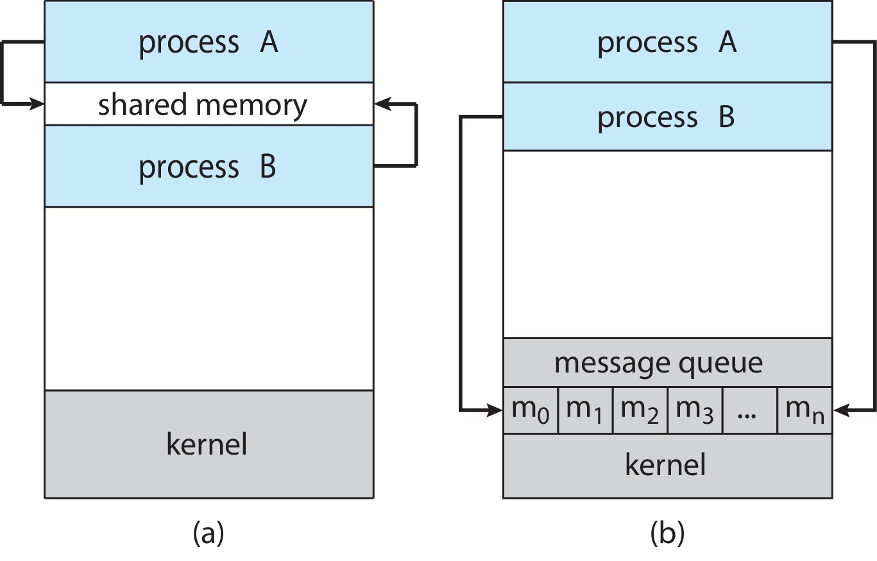
Communications Models
Shared memory
Message passing

Slide 29
IPC – Shared memory
“Processes that wish to communicate
set up a shared memory region in user space, via OS”
  data is exchanged thru read / write to shared region
  comm is under control of user processes (not the OS)
  reading is non-destructive
Major issue…
  processes need some mechanism to synchronize their actions when they access shared memory
  (Process synchronization is discussed in detail later)
29

Slide 30
IPC – Message Passing
“Processes that wish to communicate
set up a Communication link in kernel space, via OS”
  messages exchanged via read/write to comm link
  link may be unidirectional or bi-directional
IPC facility provides two operations:
  Send (message) Receive (message)
While sending/receiving messages
  message size is either fixed, or variable
  read operation has destructive semantics
  synchronization between reader & writer is implicit
30

Slide 31
IPC – Message Passing
Message passing may be either blocking or non-blocking
Blocking → called as Synchronous
  blocking send – sender blocked until message received
  blocking receive – receiver blocked until message available
Non-blocking → called as Asynchronous
  non-blocking send – sender sends message
  & continues
  non-blocking receive – receiver receives either:
  Valid message or Null message
Transfer is either byte stream oriented, or message oriented

Slide 32
IPC Taxonomy
IPC
Message Passing
Shared Memory
Byte Stream
Message Oriented
SysV SM
POSIX SM
Pipes
SysV MQ
Memory Mappings
FIFOS
POSIX MQ
Stream Sockets
Datagram Sockets
32

Slide 33
Pipes & FIFOs
Pipes (Anonymous)
Parent-child relation needed between comm processes
  typically, parent creates a pipe to comm with child
Comm is unidirectional for one Pipe
  sender writes to one end of pipe → write end
  receiver reads from other end of pipe → read end
Named Pipes (FIFOs)
Parent-child relation not needed between processes
  allow comm between unrelated processes
  several processes can use the named pipe for comm
One FIFO provides unidirectional comm

Slide 34
Sockets
Pipes, FIFOs, Shared memory & Message queues used for IPC by processes running on same system
Sockets
Allow comm between processes running on remote systems,
in distributed environment
(client-server comm paradigm)
  Stream sockets – for reliable byte stream transfer
  Datagram sockets – for unreliable message passing
  each remote process identified by a unique socket address
  facilitate comm across the Internet
  (also on the same system)

Slide 35
IPC - Use of Pipes
  (Shell & C Program)
35

Slide 36

UNIX IPC Tool: Pipes
Pipes - used for communication between related processes on same UNIX system (parent-child-sibling)
P1
P2
Pipe
36

Slide 37
Pipes in Shells
Shell has pipe operator | to connect stdout of one shell command to stdin of another command
cmd1 | cmd2 | cmd3 | … | cmdN
  stdout of cmd1 → connected to stdin of cmd2
  stdout of cmd2 → connected to stdin of cmd3
  stdout of cmdN-1 → connected to stdin of cmdN
cmd1
pipe
cmd2
pipe
pipe
cmdN
37
Notes:
Collaboration allows faults to propagate…

Slide 38
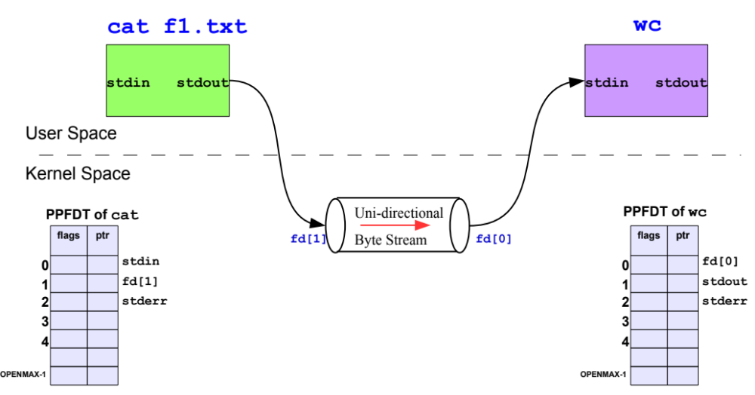
Pipes in Shells
$ cat f1.txt | wc
f1.txt
38

Slide 39
Pipes in Shells
Example: Write a command to display contents of /etc/ directory, one page at a time
$ ls –l /etc/ 1> temp
$ less 0< temp
after this, need to remove temp file as well
$ rm temp
needed three commands to accomplish the task
slow, as it involves many disk read & write operations
Using pipe symbol
$ ls –l /etc/ | less
net effect of this command is same
faster, as pipe is implemented in main memory
doesn’t use hard disk to connect stdout of ls to stdin of less
39
Notes:
Collaboration allows faults to propagate…

Slide 40
Pipes in Shells
Example: Write a command that will sort file friends.txt & display its contents on stdout, if any
$ sort friends.txt | less
Example: Write a command that will count number of lines in man page of ls
$ man ls | wc -l
Example: Write a command that will count number of lines containing string ‘ls’ in man page of ls
$ man ls | grep ls | wc -l
40
Notes:
Collaboration allows faults to propagate…

Slide 41
Pipes in C program
Pipe is created using pipe() function call
#include <unistd.h>
int pipe ( int fd [2] ) ;
Returns: 0 if OK, -1 on error
Call creates 02 file descriptors,
opened for read & write
operation
fd [0] → for reading
fd [1] → for writing
process
fd[0]
fd[1]
process
kernel
pipe
Flow of data
41

Slide 42
Pipe in a Single Process
Pipe is a fixed size circular buffer created by kernel…
  I/O on pipe → call read() & write()
  data written on fd[1] → readily available on fd[0]
  if pipe is empty → read() is blocked
  synchronization issue → handled by kernel
Pipe is created in a single process
but used for comm between two processes (parent/child)
How…??
process
fd[0]
fd[1]
process
kernel
pipe
Flow of data
42

Slide 43
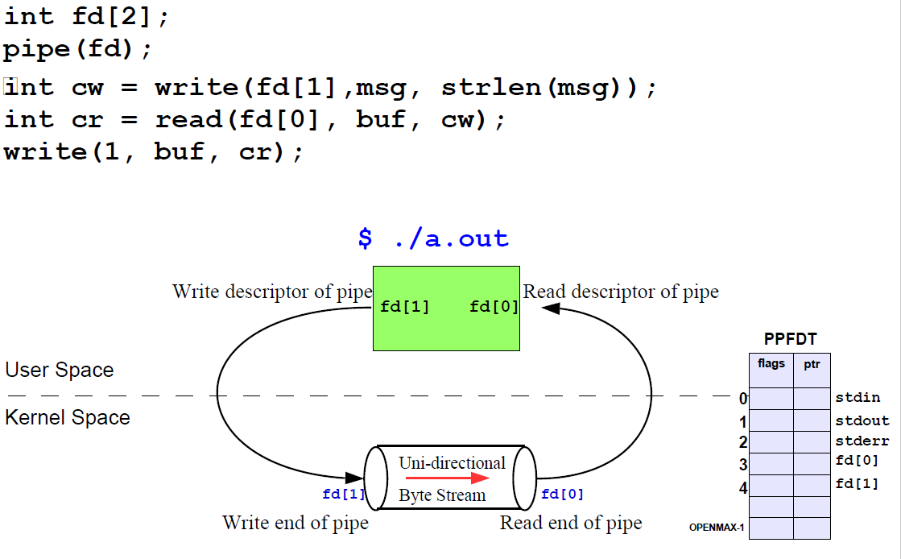
Pipe in a Single Process
43

Slide 44
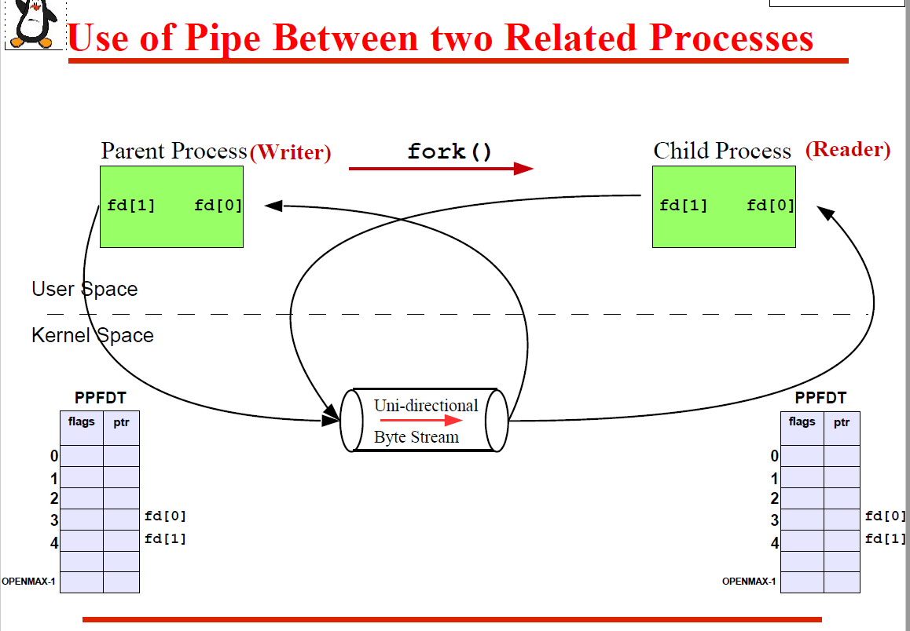
Pipes in 2 Related Processes

Slide 45
Pipes in 2 Related Processes
Parent creates a pipe
Then calls fork() to create a copy of itself
fork()
parent
fd[0]
child
fd[0]
fd[1]
fd[1]
process
kernel
pipe
Flow of data

Slide 46
Pipes in 2 Related Processes
Parent closes read end of pipe & child closes write end
This provides a one way flow of data between the two processes
parent
child
fd[0]
fd[1]
process
kernel
pipe
Flow of data

Slide 47
Full Duplex Pipe : 2 Related Processes
Steps to create Full Duplex Pipe
  Create pipe 1; fd1[0], fd1[1] pipe 2; fd2[0], fd2[1]
  fork()
  Parent closes read end of pipe 1; fd1[0]
  Child closes write end of pipe 1; fd1[1]
  Child closes read end of pipe 2; fd2[0]
  Parent closes write end of pipe 2; fd2[1]
parent
child
fd2[0]
fd2[1]
fd1[1]
fd1[0]
process
kernel
Flow of data
pipe 1
pipe 2
Flow of data
47

Slide 48
For bi-directional flow of data…
Full Duplex Pipe : 2 Related Processes
parent
child
fd2[0]
fd2[1]
fd1[1]
fd1[0]
process
kernel
Flow of data
pipe 1
pipe 2
Flow of data
48

Slide 49
Use of Named Pipes
  (Shell & C Program)
49

Slide 50

Unix IPC Tool: FIFO
Named Pipes (FIFOs)
used for communication between related or unrelated processes on same UNIX system
  no parent-child relationship needed between processes
P1
P2
p1
p2
FIFO
50

Slide 51
Unix IPC Tool: FIFO
FIFO, or named pipe, is a special type of file with a pathname associated with it
  allows unrelated processes to comm through a file interface
  processes read & write to the same file
When processes read/write data via FIFO…
  kernel passes all data internally; no contents on file system
  pathname is only a reference for access, via name in file system
FIFO is created by one process, and can be opened for read & write by multiple processes
  persists beyond the lifetime of process that created it
  process opening a FIFO for read blocks, until other process opens same FIFO for write
51

Slide 52
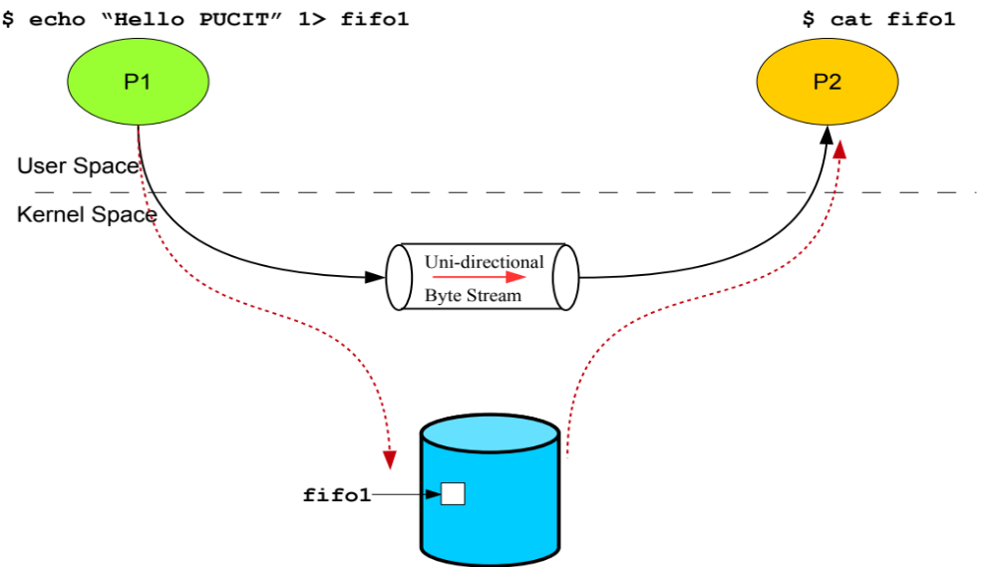
FIFO in Shells
$ mkfifo fifo1
52

Slide 53
FIFO in Shells
Example: first create a fifo and write to it in one terminal; and then read the fifo in another terminal
terminal 1 terminal 2
$ mkfifo myfifo $
$ cat > myfifo $ cat myfifo
$ I am here… $ I am here…
$ ^D $
53
Notes:
Collaboration allows faults to propagate…

Slide 54
FIFO in C program
  The following function is used to create a FIFO…
  int mkfifo (const char *pathname, mode_t mode);
  (creates a FIFO; returns 0 on success; -1 on failure with errno set)
  pathname : FIFO special file has the name ‘pathname’
  mode : file permissions for user, group, or others
  to allow read, write, or execute access
Call fails when…
  Parent directory does not allow write permission
  Pathname already exists, or too long
  Pathname points outside accessible address space
  Insufficient kernel memory
54

Slide 55
Example – FIFO
int main() {
mkfifo("/tmp/my_fifo", 0666);
pid_t child_pid = fork();
if (child_pid == 0) {
writer_process();
}
else {
reader_process();
}
return 0;
}
55

Slide 56
Example – FIFO
void writer_process() {
int fifo_fd = open("/tmp/my_fifo", O_WRONLY);
const char* message = "Hello from Writer!";
write(fifo_fd, message, strlen(message));
close(fifo_fd);
}
56

Slide 57
Example – FIFO
void reader_process() {
int fifo_fd = open("/tmp/my_fifo", O_RDONLY);
char buffer[100];
read(fifo_fd, buffer, sizeof(buffer));
printf("Reader received: %s\n", buffer);
close(fifo_fd);
unlink(FIFO_PATH);
}
57

Slide 58
IPC
Using Shared Memory
58

Slide 59
POSIX Shared Memory
Process first creates shared memory segment
shm_fd = shm_open(name, O CREAT | O RDWR, 0666);
  also used to open an existing segment
Set the size of the object
ftruncate(shm_fd, 4096);
Use mmap() to memory-map a file pointer to the shared memory object
Read & write to shared memory by using pointer from mmap()

Slide 60
POSIX Shared Memory
mmap() memory-maps a file pointer to the shared memory object
void *mmap(void *addr, size_t length,
int prot, int flags, int fd, off_t offset);

Slide 61
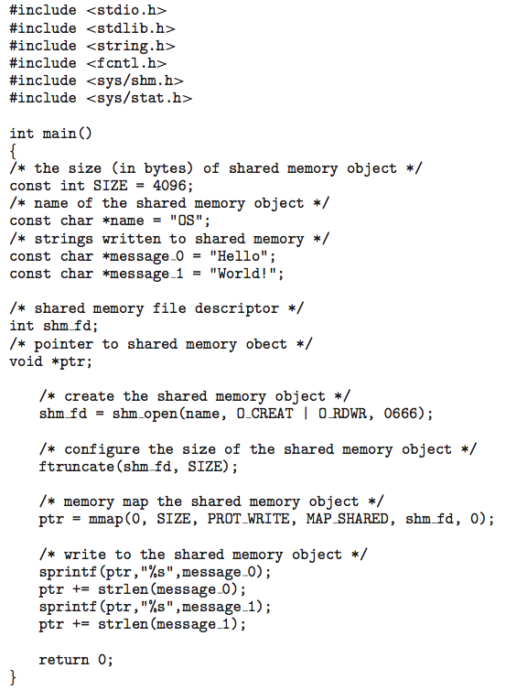
Shared Memory - Producer

Slide 62
Shared Memory - Producer

Slide 63
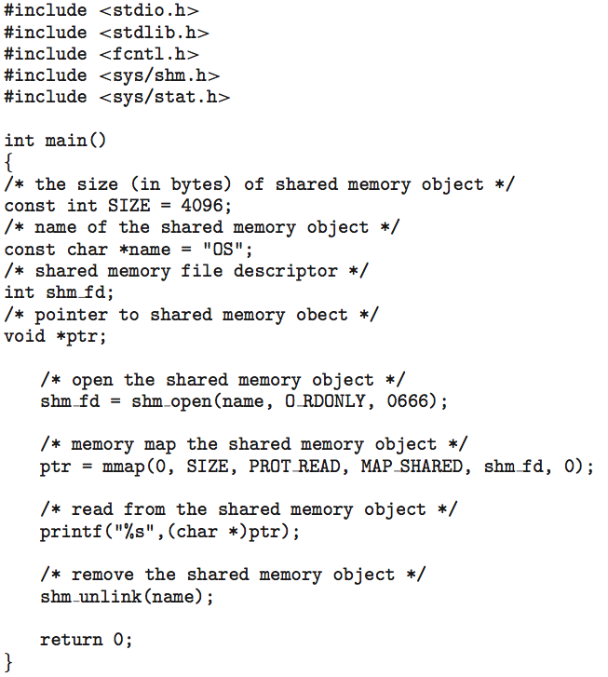
Shared Memory - Consumer

Slide 64
Shared Memory - Consumer

